Slide 1


Integrating business, education & research: The KNOW-FACT Knowledge Alliance
Dr. Dimitris Mavrikios
Laboratory for Manufacturing Systems & Automation
Director: Prof. George Chryssolouris
Department of Mechanical Engineering and Aeronautics
University of Patras, Greece
http://www.lms.mech.upatras.gr/

Slide 2
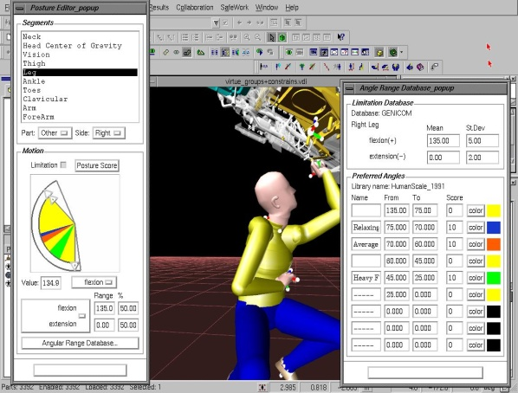
Organization profile
LMS is oriented on research and development in cutting edge scientific and technological fields.
LMS is involved in a number of research projects funded by the CEU and European industrial partners. Particular emphasis is given to the co-operation with the European industry as well as with a number of "hi-tech" firms.
LMS is organized in three different groups:
Manufacturing Processes Modelling and Energy Efficiency
Robotics, Automation and Virtual Reality in Manufacturing
Manufacturing Systems

Slide 3

http://www.knowfact-project.eu/
A Knowledge Partnership for the definition and launch of the European Teaching Factory paradigm
in manufacturing education

Slide 4
Background
Manufacturing is a subject that cannot be handled efficiently, only inside a classroom.
The development of educational curricula has not kept pace with the growing complexity of industry, technology and economy.
Research outcomes of educational institutions are typically presented to the scientific community without having been directly accessible to industry. Within this context, industry may not either comprehend or adapt to the technological advances in a direct way.
Thus, the promotion of a novel approach to manufacturing education that would integrate education, research and innovation, emerges as a key challenge

Slide 5
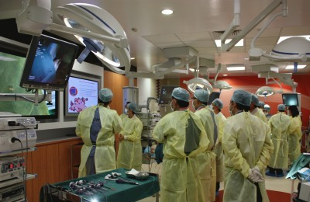
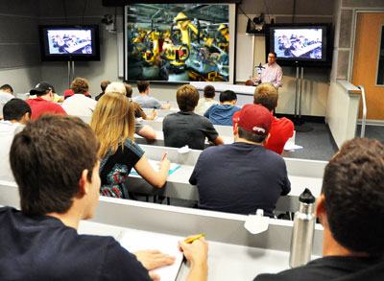
Background
The concept of the Teaching Factory has its origins in the medical sciences discipline and specifically in the paradigm of the teaching hospitals.
Aiming to become a new paradigm in engineering education and training, the Teaching Factory initiative will have a hybrid mission:
Industrial training and education for university students
Take-up of research results and training for industry engineers & blue-collar workers

Slide 6






Partnership
Project Coordinator
Laboratory for Manufacturing Systems & Automation
Director: Prof. George Chryssolouris
University of Patras, Greece

Slide 7
Objective and outputs
The KNOW-FACT objective has been to launch a University-Business cooperation to elaborate and validate the emerging concept of the Teaching Factory at a European level and identify its exploitation potential.
KNOW-FACT has delivered:
A complete study for the conceptualization and implementation of the Teaching Factory initiative, including the
concept definition
layout and technological infrastructure specification
learning content definition
Pilot runs for the validation of the underlying concepts and the delivery mechanisms
An Extended Partnership of associated academic and industrial organizations to support follow-up and future implementation activities

Slide 8
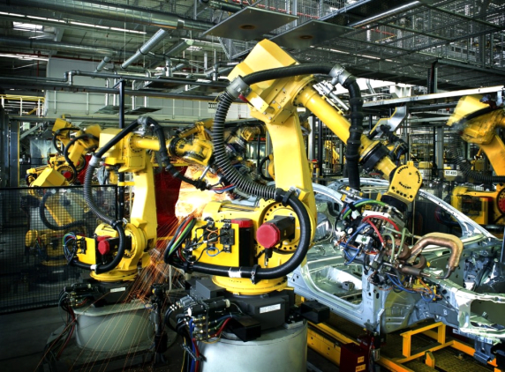
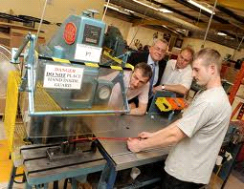
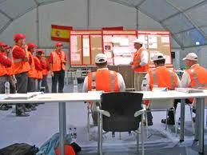


Approach
research
KNOWLEDGE
education
innovation
The Teaching Factory as a 2-ways
“learning channel” communicating
… industrial practices to the classroom
… “new” knowledge to the factory

Slide 9
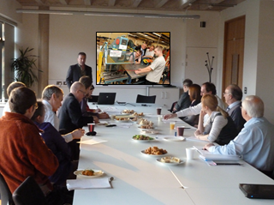
Approach
“Factory to Classroom”
“Lab to factory”
Students in the classroom act as the knowledge “receivers”
On the industry side, engineers introduce and present real shop floor problems
Student projects are launched on the basis of the shop-floor problems
Engineers at an industrial site act as the knowledge “receivers”
Academic facilities provide the test-bed for presenting and demonstrating research results.
New solutions to industrial problems are investigated on the basis of these results.

Slide 10
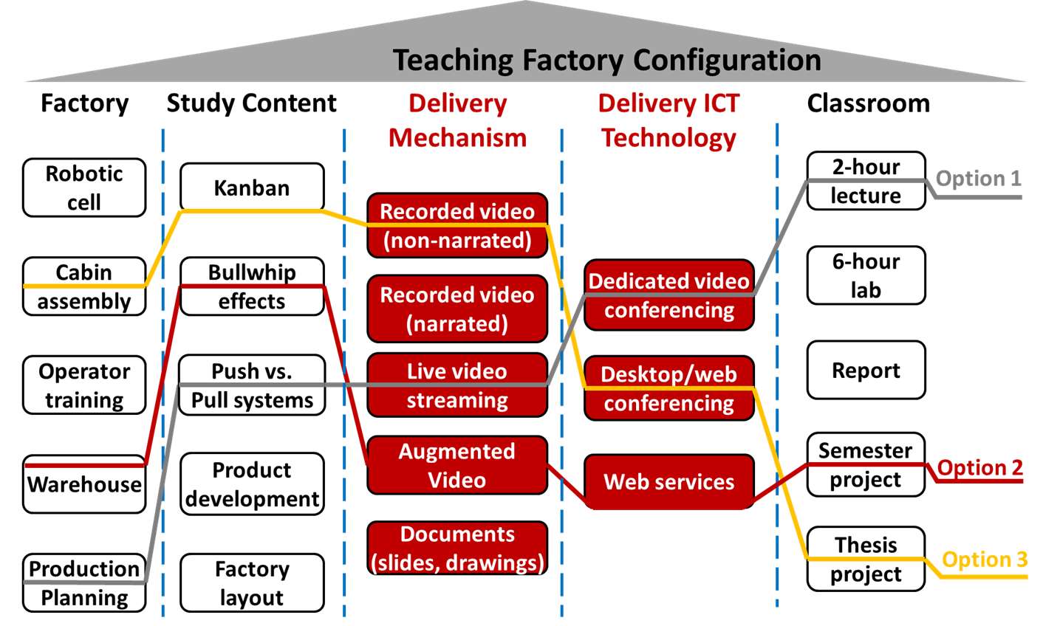
Approach
Modular configuration of the factory-to-classroom knowledge communication

Slide 11
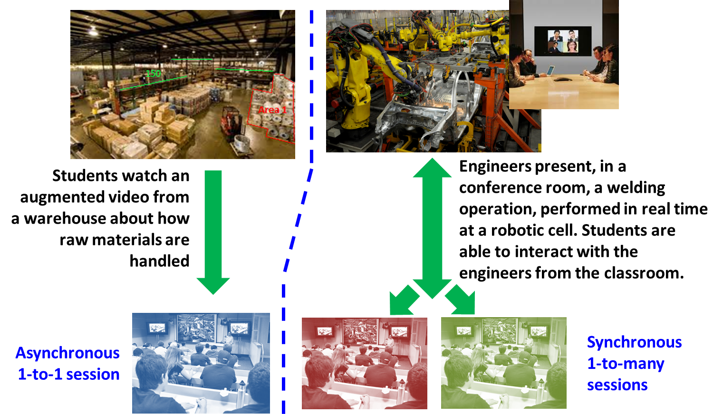
Approach
Multiple layouts of the factory-to-classroom knowledge communication channel

Slide 12
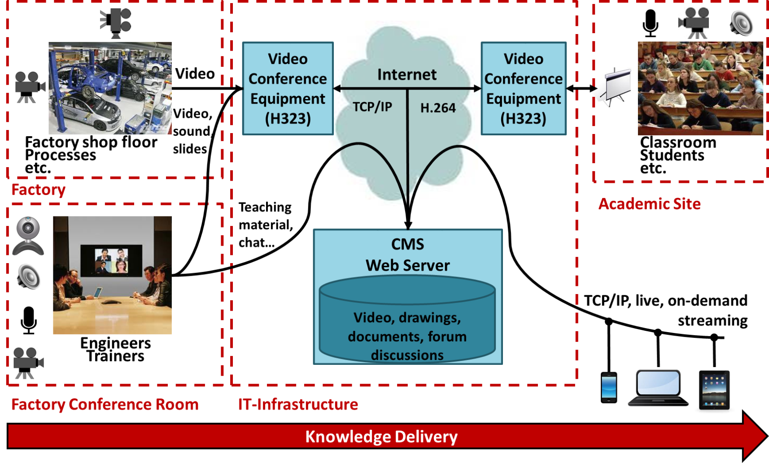
Approach
Generic ICT infrastructure for the factory-to-classroom knowledge communication

Slide 13


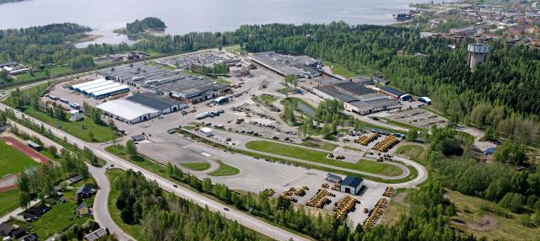
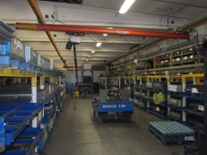
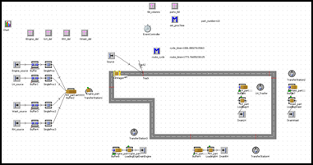
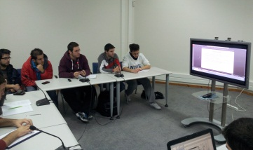

Pilot project
Industry
knowledge transfer
Academia
Industrial problem:
line balancing of a new production area
planning of material kitting area
4 Volvo engineers
20 LMS students
6 weeks (2h session per week)

Slide 14
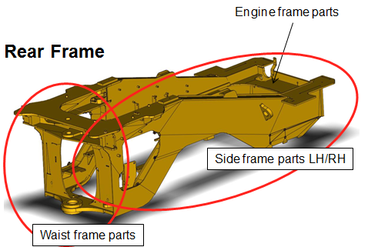
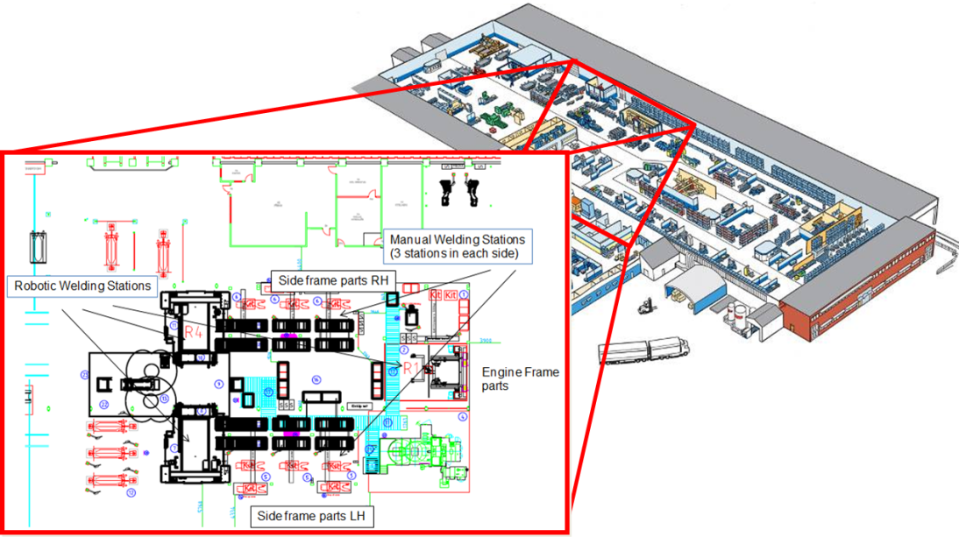
Pilot project
Volvo Construction Equipment
Material flow simulation project
Use of DES (discrete event simulation) software to address the problem

Slide 15
Pilot project
Task 1
Expected output from experiments:
Strategy for work load in each station. It is possible to adjust number of operations (processing time). How is this effecting output with a given mean downtime
Deviation in process times, sensitivity?
Task 2
Expected output:
Understanding of optimal positions of different component types depending on variant penetration / frame sequence. (When producing all planned variants) Planned location of material containers. Proposal on manning.
Finally this model should be able to feed the frame production model with input.

Slide 16
Pilot project
Implementation plan
Weekly cycle
13.11.12
Introduction to VCE production and problem definition
Supporting Class (4h)
20.11.12
Discussion on problem
27.11.12
Initial theoretical approach
Project work (5h)
Project work (5h)
04.12.12
Evaluation of model design and approach
11.12.12
First draft results
TF Session (2h)
18.12.12
Solution presentation
15.01.13
Follow-up on solution and discussion

Slide 17
Pilot project
Achievements – The business perspective
Solution viability:
The total solution is extensive and many aspects are investigated.
The total solution will be useful in future preparation work.
Solution optimality:
Hard to answer until production running. However, the estimation is that this looks promising.
Good experience, the questions and tasks were well perceived by the students.
It was good to get other points of view about the solutions to increase the system’s output.
The long distance between plant and university had not a negative impact on the result.
The result was both a confirmation on our own planning but the students did also contribute with some new proposals on new solutions.

Slide 18
Pilot project
Overall experience - The business perspective:
The pilot provided ideas and solutions that would not have been considered during the standard company processes of solving such problems.
It was an opportunity to give a wider range of solution proposals, which consequently resulted in better decision support.
The factory people had the chance to interact with a pool of students that had a new way of thinking and problem solving capacity.
There were cases among the students where they approached the problem with real talent and out-of-the-box thinking.

Slide 19
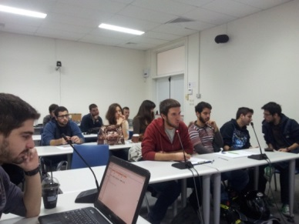
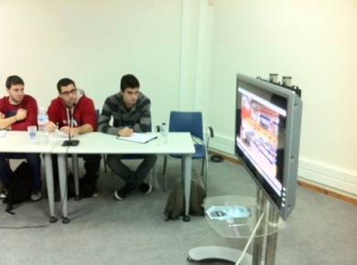
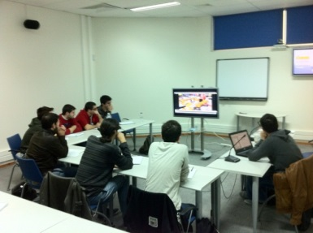
Pilot project
Achievements - The student perspective:
Introduction to a real problem being much more complicated and challenging than typical training cases → high motivation
No simplifications, actual constraints, strict deadlines, team work, competition → working under realistic conditions
Addressing difficult issues and error prone situations, yet insisting on finding solutions on their own, decision making → increased confidence
Interactions with professionals, use of English language, remote communication and use of advanced ICTs → improved communication and presentation skills
… an overall great experience, looking forward to the next Teaching Factory pilot project !!

Slide 20
Pilot project
Overall experience - The academia perspective:
New experience for both the students and the faculty.
New learning approach and knowledge delivery mechanism that is not available in theoretical lectures or one-time labs.
Gives the ability for the students to deepen their knowledge in certain topics and apply that in practice, while addressing real-life problems, and working in view of actual deadlines and industrial practice terms.
Major impact on the learning process and the development of the young engineers, but also outside the academic environment.
Promote the exciting character of manufacturing to the young people

Slide 21
Thank you for your attention!
Prof. George Chryssolouris (xrisol@lms.mech.upatras.gr)
Dr. Dimitris Mavrikios (mavrik@lms.mech.upatras.gr)
Laboratory for Manufacturing Systems & Automation
Director: Prof. George Chryssolouris
Department of Mechanical Engineering and Aeronautics
University of Patras, Greece
http://www.lms.mech.upatras.gr/

